Slide 1


ANANTHA LAKSHMI INSTITUTE OF TECHNOLOGY AND SCIENCES
Department of CSE
Project
Topic / Idea: AUTOMATIC RAILWAY GATE COMTROL
Presented by:
Name of the Student | Reg. No/ Roll No | Year/ Sec
P. Sai Sunil | 192G1A05B8 | 3rd year/B sec
R.Humer | 192G1A05A2 | 3rd year/B sec
A.Harshitha | 192G1A0562 | 3rd year/B sec
V.Roopa Sree T.Yashnamrutha M.Shafiya | 192G1A05B4 192G1A05B2 192G1A0593 | 3rd year/B sec 3rd year/B sec 3rd year/B sec

Slide 2
PROBLEM STATEMENT:Automatic Railway Gate Control System using IR Sensor , Arduino & Servo motors

Slide 3
PROPOSED SOLUTION / IDEA:
In the proposed system, 2 IR sensors are used to detect the train’s arrival and departure.
Arduino is used for programming and connecting devices like IR sensor, Servo Motor.
The servo motor is used for monitoring of gate.
LEDs are used to indicate the closure of gate for the people who try to cross the gate.

Slide 4
IMPLEMENTATION REQUIREMENTS OF PROPOSED IDEA
Block Diagram
MOTOR
ARDUINO
UNO
IR
SENSOR-1
GATE
GATE
IR
SENSOR-2
MOTOR

Slide 5

The detection of arrival and departure of a train is done by using two IR sensors.
The gate will be opened and closed by using servomotors.
Servomotors are controlled by Arduino Uno Processor.LEDs are used to indicate the closure of gate for the people who try to cross the gate.
The hardware is supported by Arduino.

Slide 6

1.Arduino Uno Processor
2.IR Sensors
3.Servomotors
4.LEDs
5.Conecting wires
6.ML Trained Camera

Slide 7
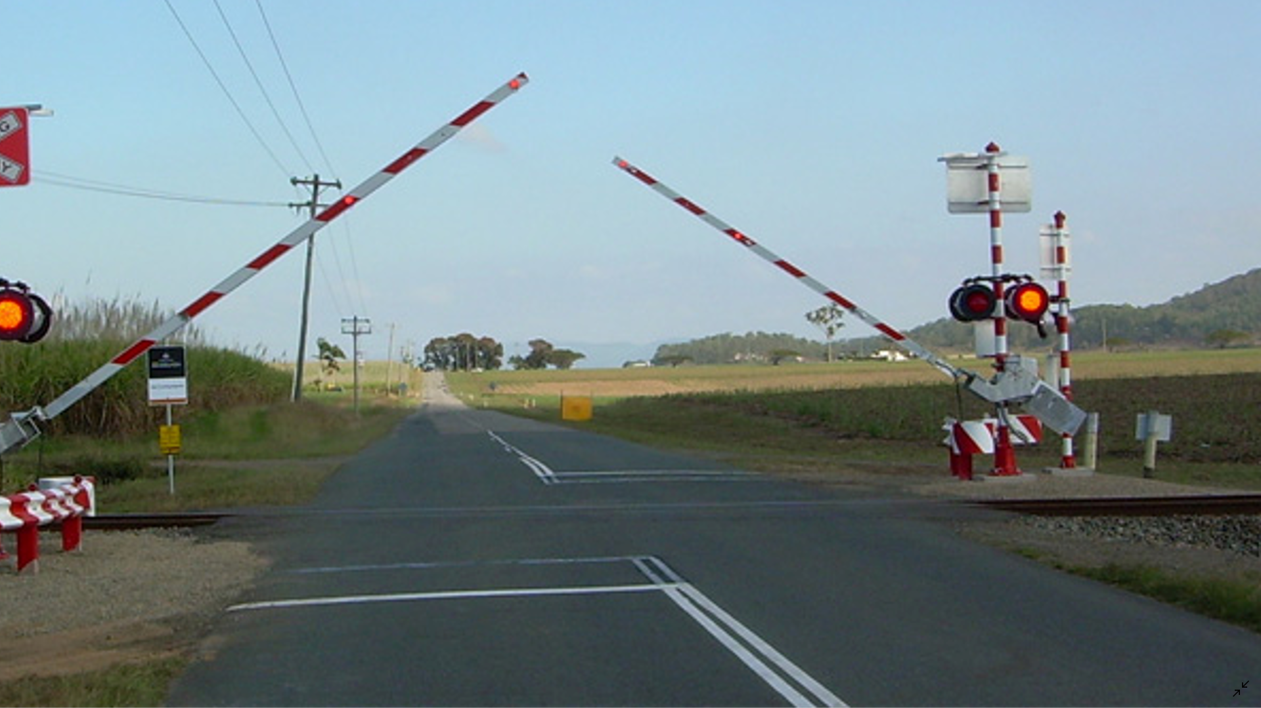
Before Arrival of Train

Slide 8
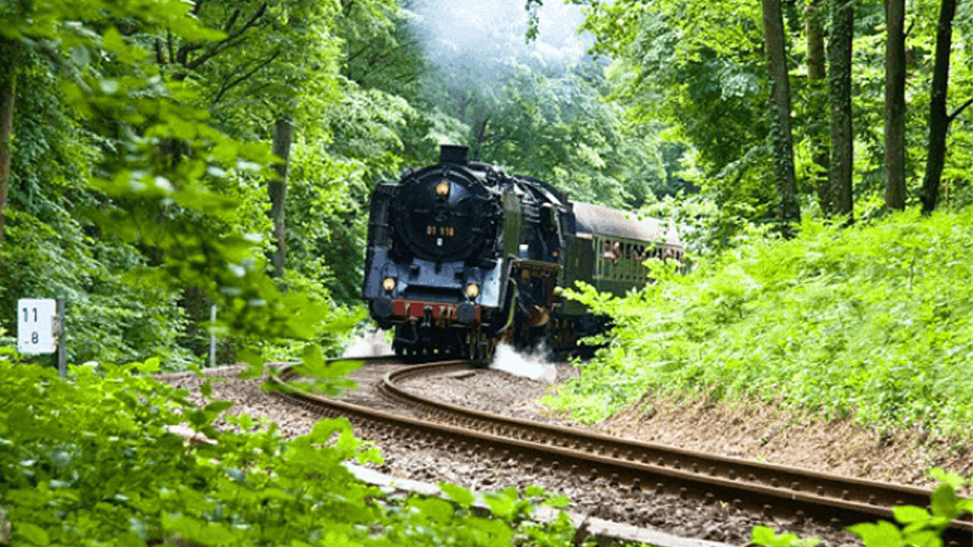
Here when train is arriving then IR sensor will be activated and send’s high signal-1 to Arduino. And then with help of Arduino the Servomotor rotates 90-0 degrees.by this Gates will be Closed.

Slide 9
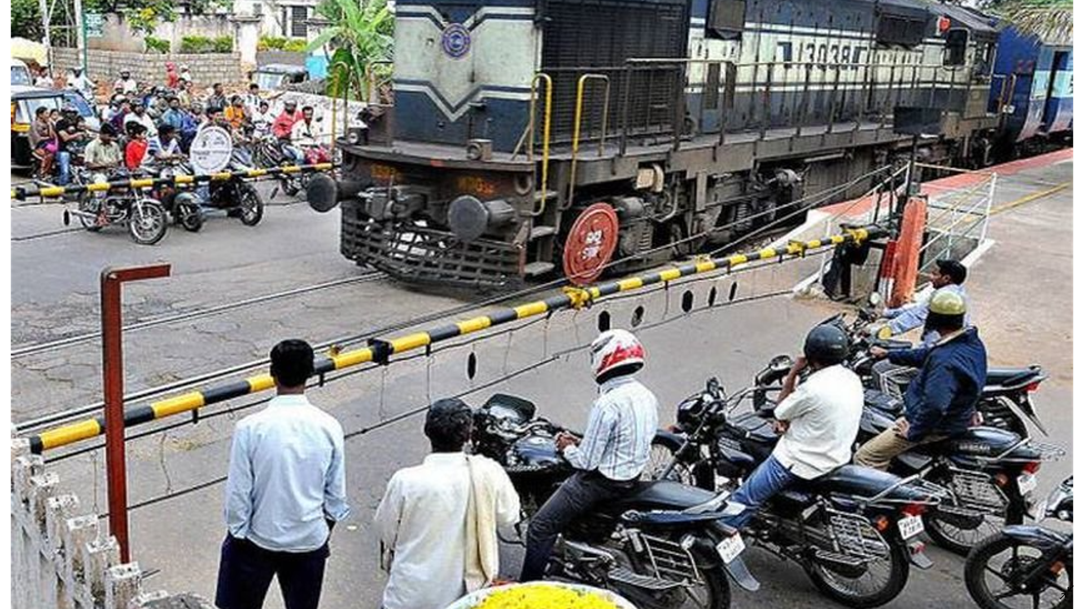
After arrival of Train
After arrival of train the Gates will be in closed

Slide 10
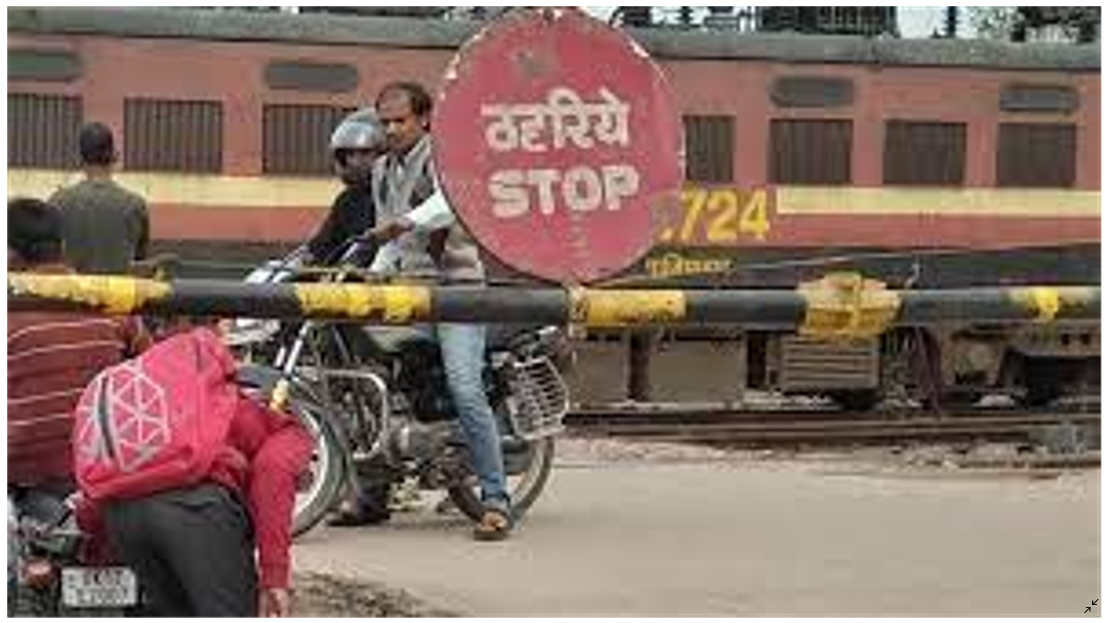
Here when people tried to pass gate even the gates are closed.Then the Cameras Trained with Machine Learning will capture that vehicle number,his/her face and send’s to Railway gate operators and police station.
Then the operators lift the Gate and Police will make fine on them.

Slide 11
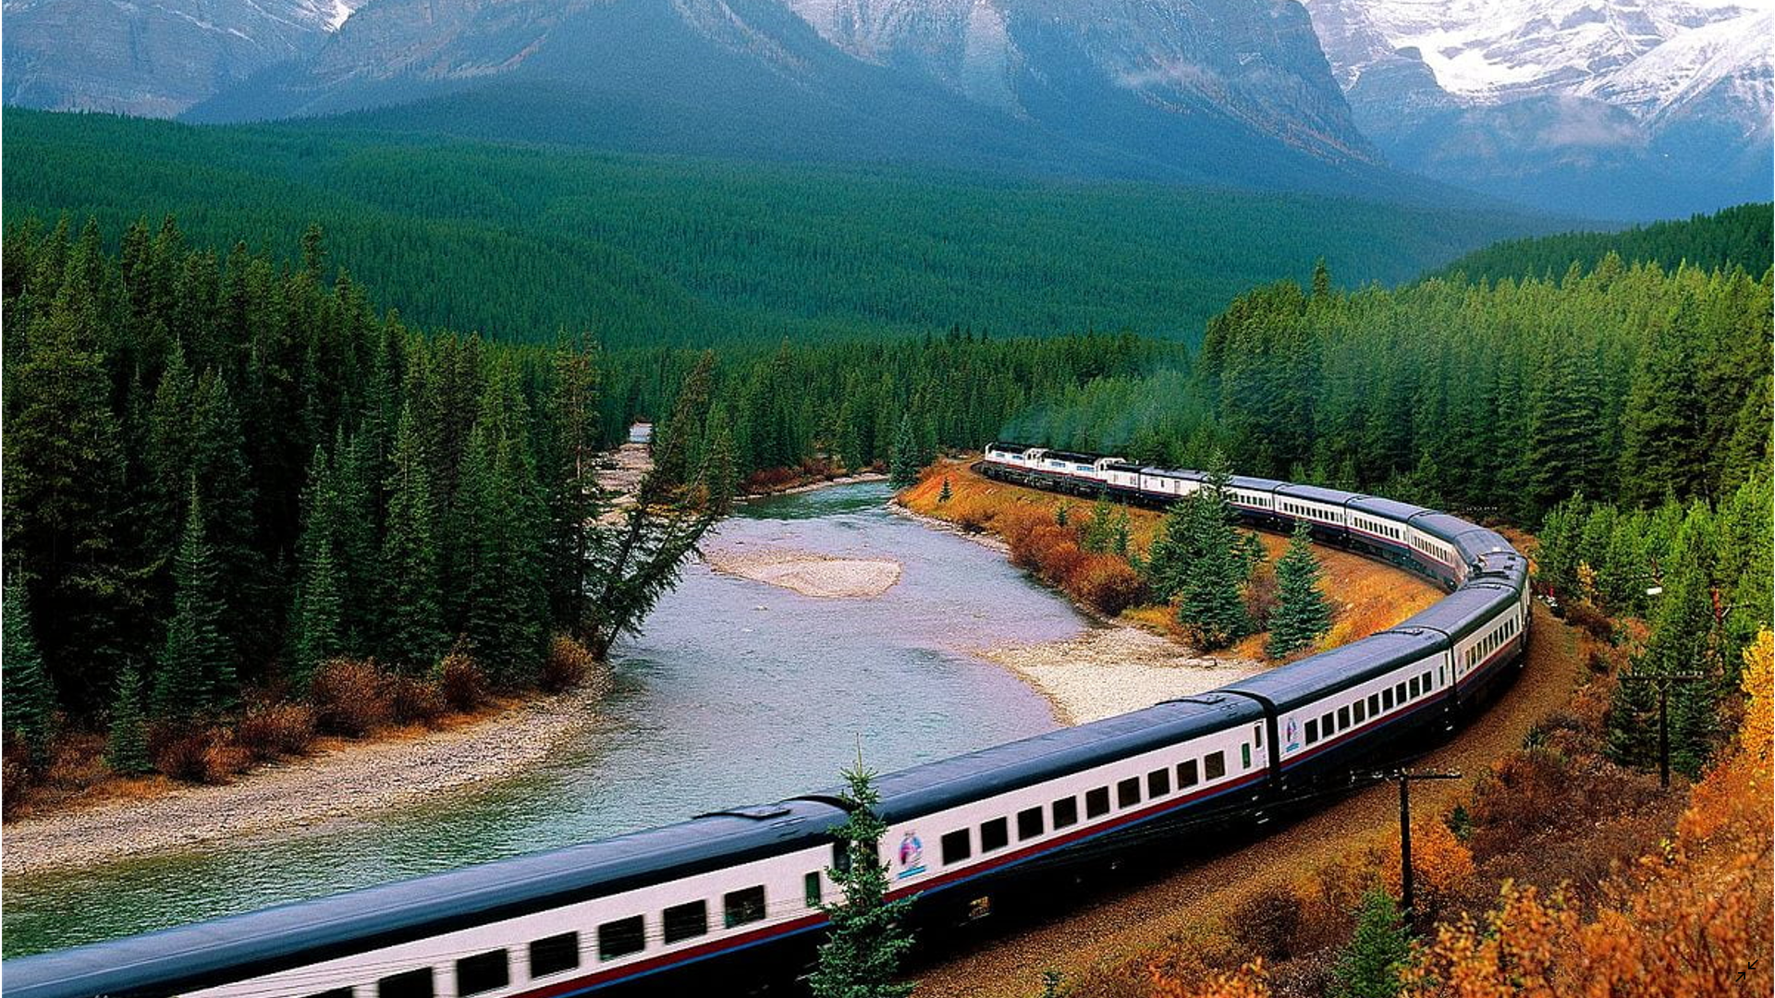
After Train passed out railway gate.the another sensor will be activated and send’s signal-1 to Arduino. With the help of Arduino the Servomotor now rotate from 0-90 degree.By this Gates will be opened.

Slide 12
ADVANTAGES OF PROPOSED SOLUTION
1.No need of gate keeper
2.More reliable
3.Maintanence is easy
4.Time Saving

Slide 13
CONCLUDING REMARKS
The Automatic Railway gate control using Arduino is a new method.
The Accident rate can be reduced at level crossings.
Hence without human force can control the Gates.

